Slide 1
The New Survey
MaLisa Spring

Slide 2
Goals:
• Identify every species known for each county, including new records, and rare species
•Determine current distribution and abundance
• Access historical collections and incorporate into database
• Create a layperson book on all Ohio Odonata with distribution maps

Slide 3
Where are we now?
Data from OOS up to Dec ’16
Maps made in R with ggmaps

Slide 4
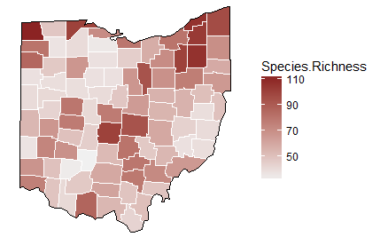
Where are we now?
Highest richness:
Williams: 112/165
Lake: 109
Geuga: 108
Protage:108
Summit: 108

Slide 5
Where are we now?
Lowest richness:
Fayette: 32/165
Clinton: 34/165
Sandusky: 35/165
Henry: 37/165

Slide 6
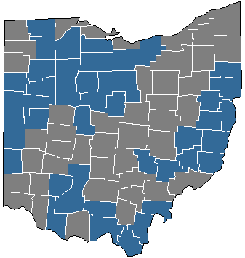
Where to focus?
Counties with fewer than 300 observations* in database
43 counties!

Slide 7
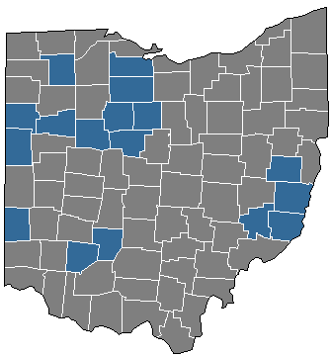
Where to focus?
Counties with fewer than 40 species in database
17 counties!

Slide 8
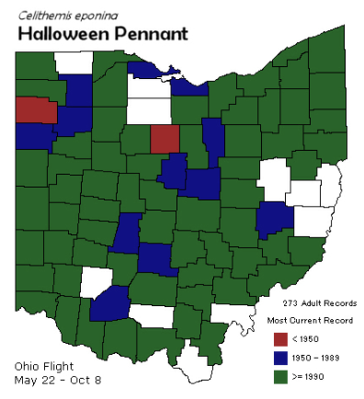
Where to focus?
Cover the map

Slide 9
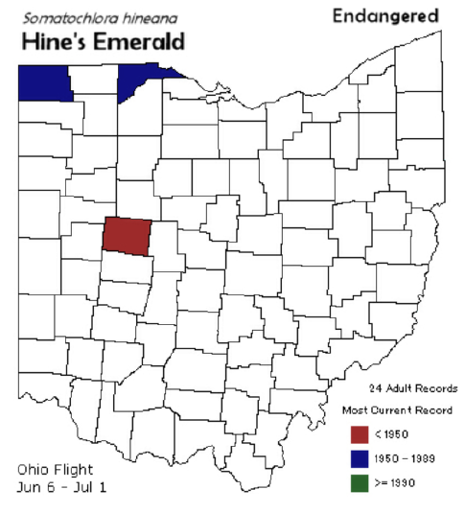
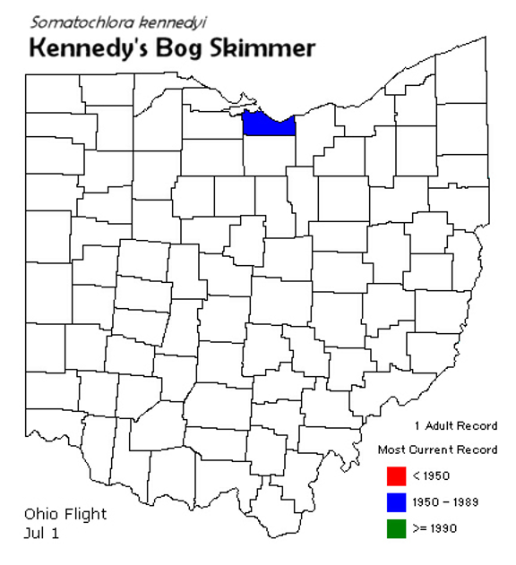
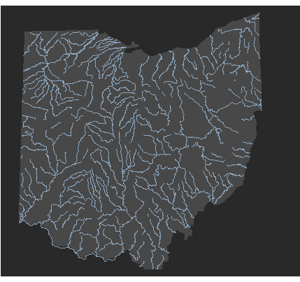
Where to focus?
Habitat specific searches

Slide 10
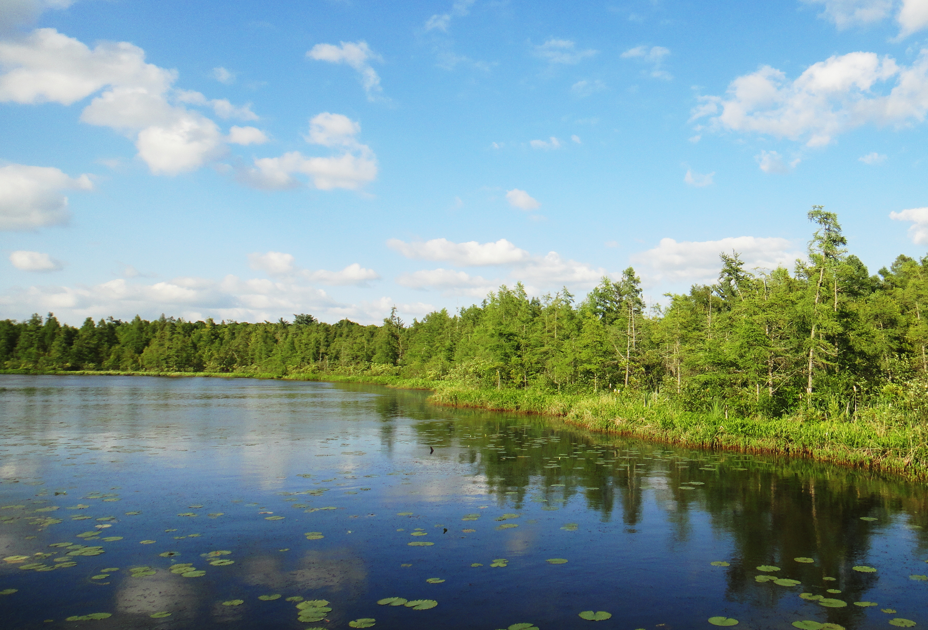
Where to focus?
Preserved/pristine habitat
BUT

Slide 11
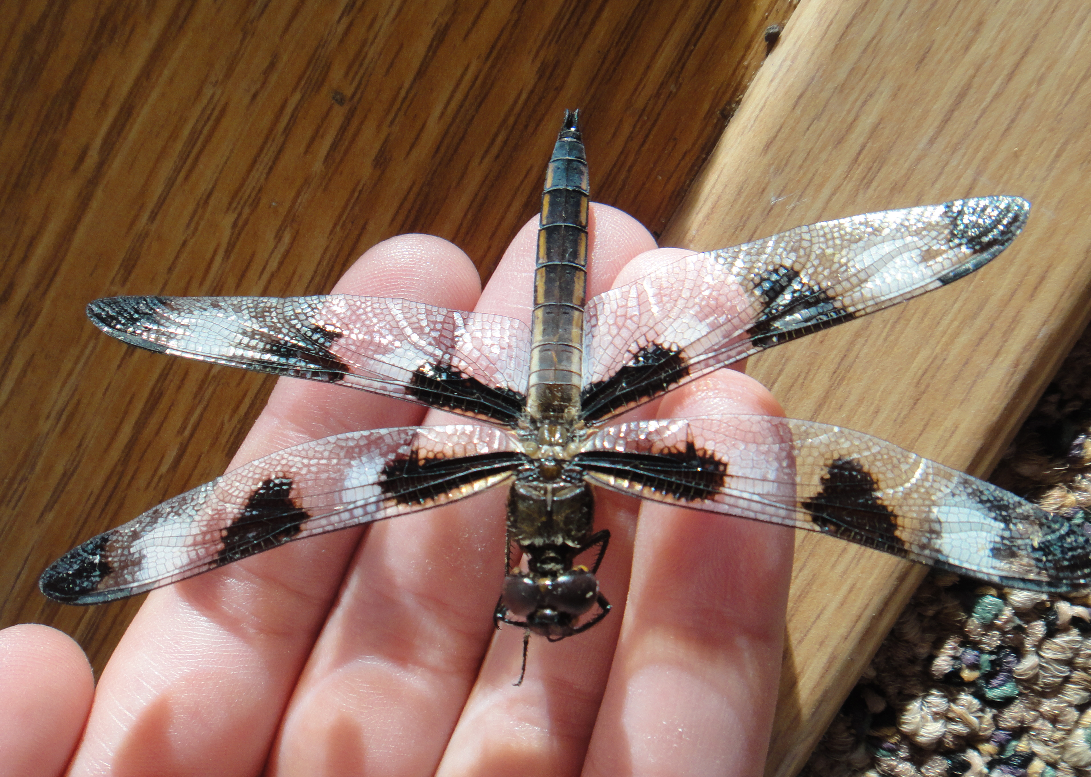
How can you help?
Physical collections
Photo submissions
Vetting ID’s on iNaturalist

Slide 12
Organization
MaLisa Spring
Norm Johnson
Shane Myers
Jim Lemon
M. S. and Bob Glotzhober
Linda Gilbert
Lynda Andrews

Slide 13
Regions
Same as ODNR
1. M. Spring & Bob G.
2. Shane Myers
3. Linda Gilbert
4. Lynda Andrews
5. Jim Lemon

Slide 14
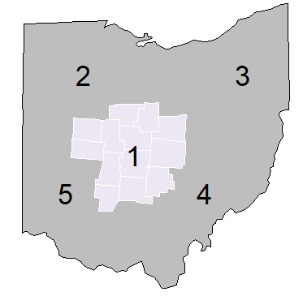
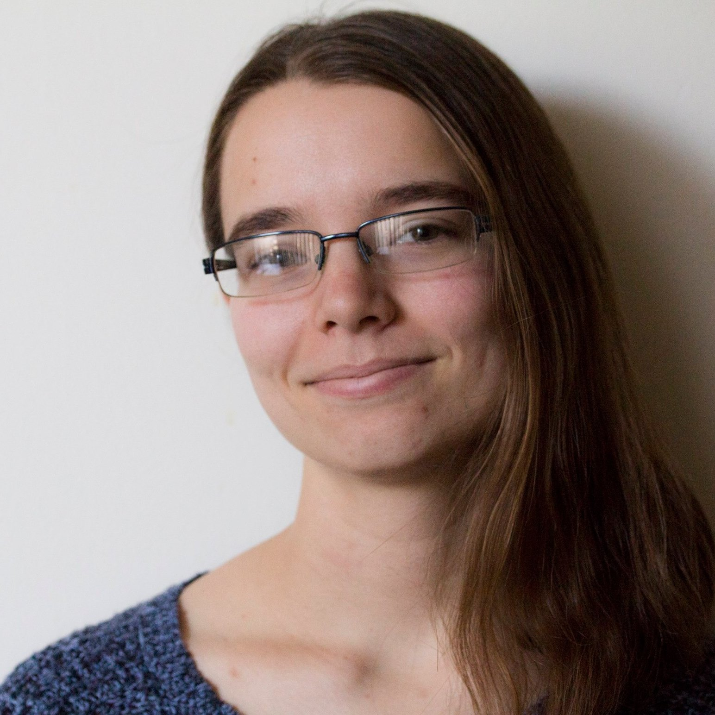
Meet your coordinator: State & CE
MaLisa Spring
Master’s of Science in Entomology from The Ohio State University
Bachelor’s of Science in Biology from Marietta College

Slide 15
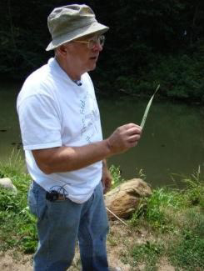
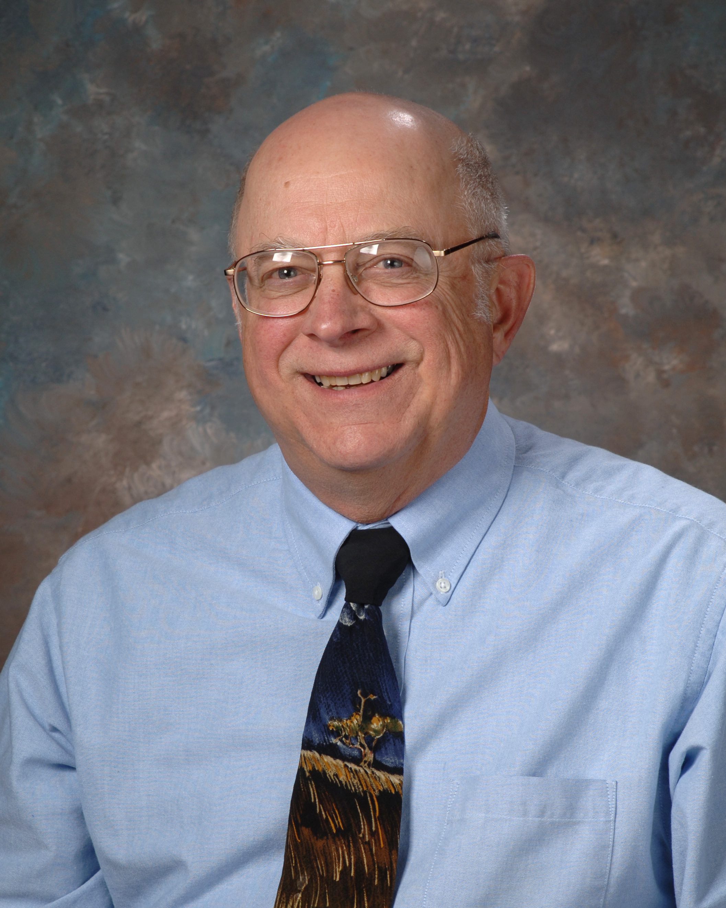
Meet your coordinator: Central
Bob Glotzhober
33 years at Ohio Historical Society
Coordinated previous 1991-1999 state wide survey

Slide 16
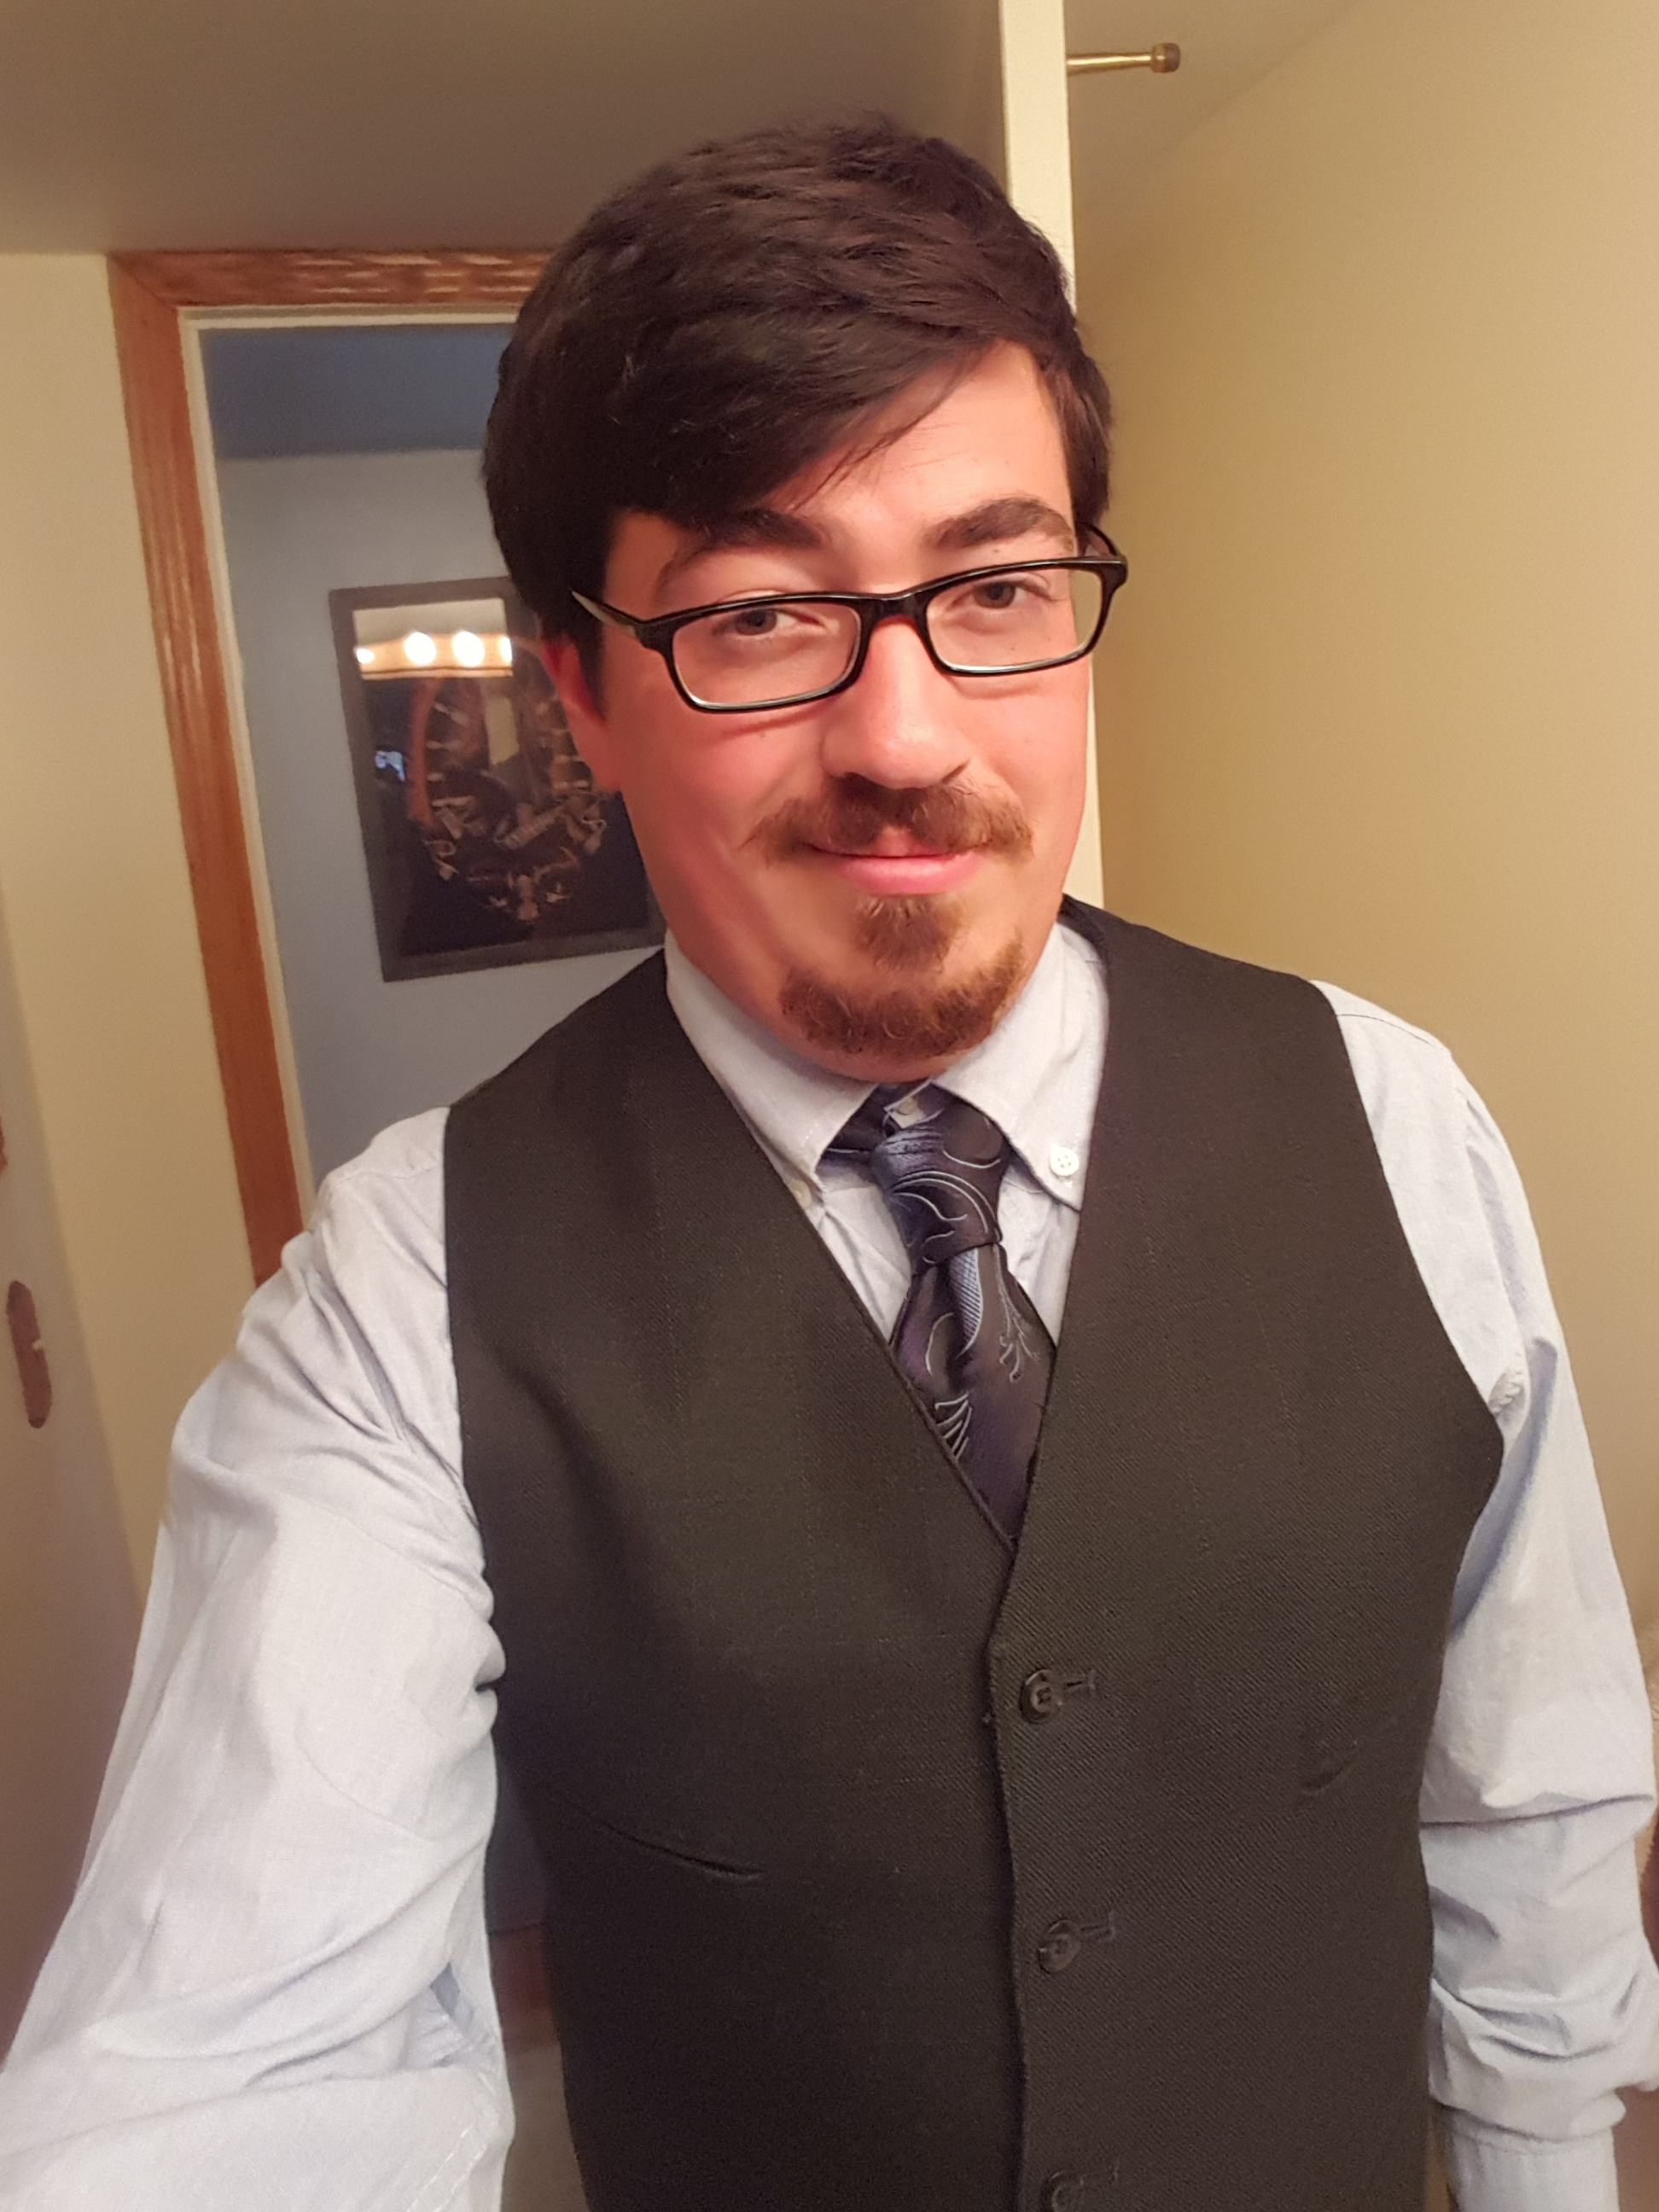
Meet your coordinator: Northwest
Shane Myers
Bachelor’s in Wildlife Biology from University of Findlay
Blanchard River Watershed Partnership and Hancock Co. Parks Foundation

Slide 17
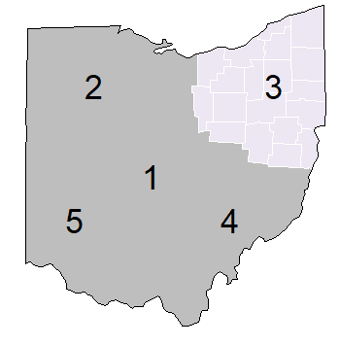
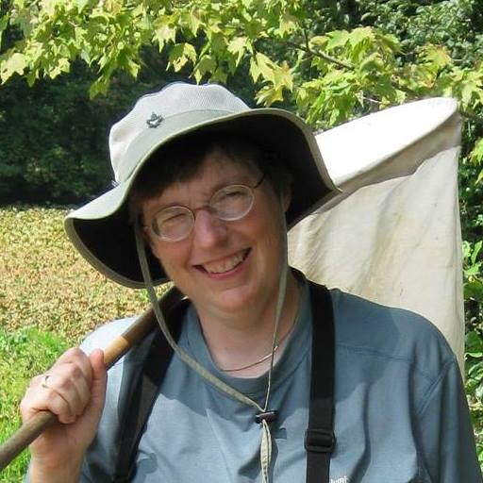
Meet your coordinator: Northeast
Linda Gilbert
Naturalist at the Geauga Park District
Co-author of Dragonflies and Damselflies of Northeast Ohio

Slide 18
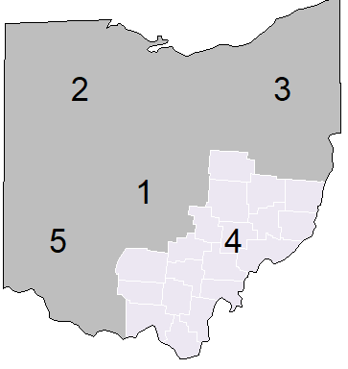
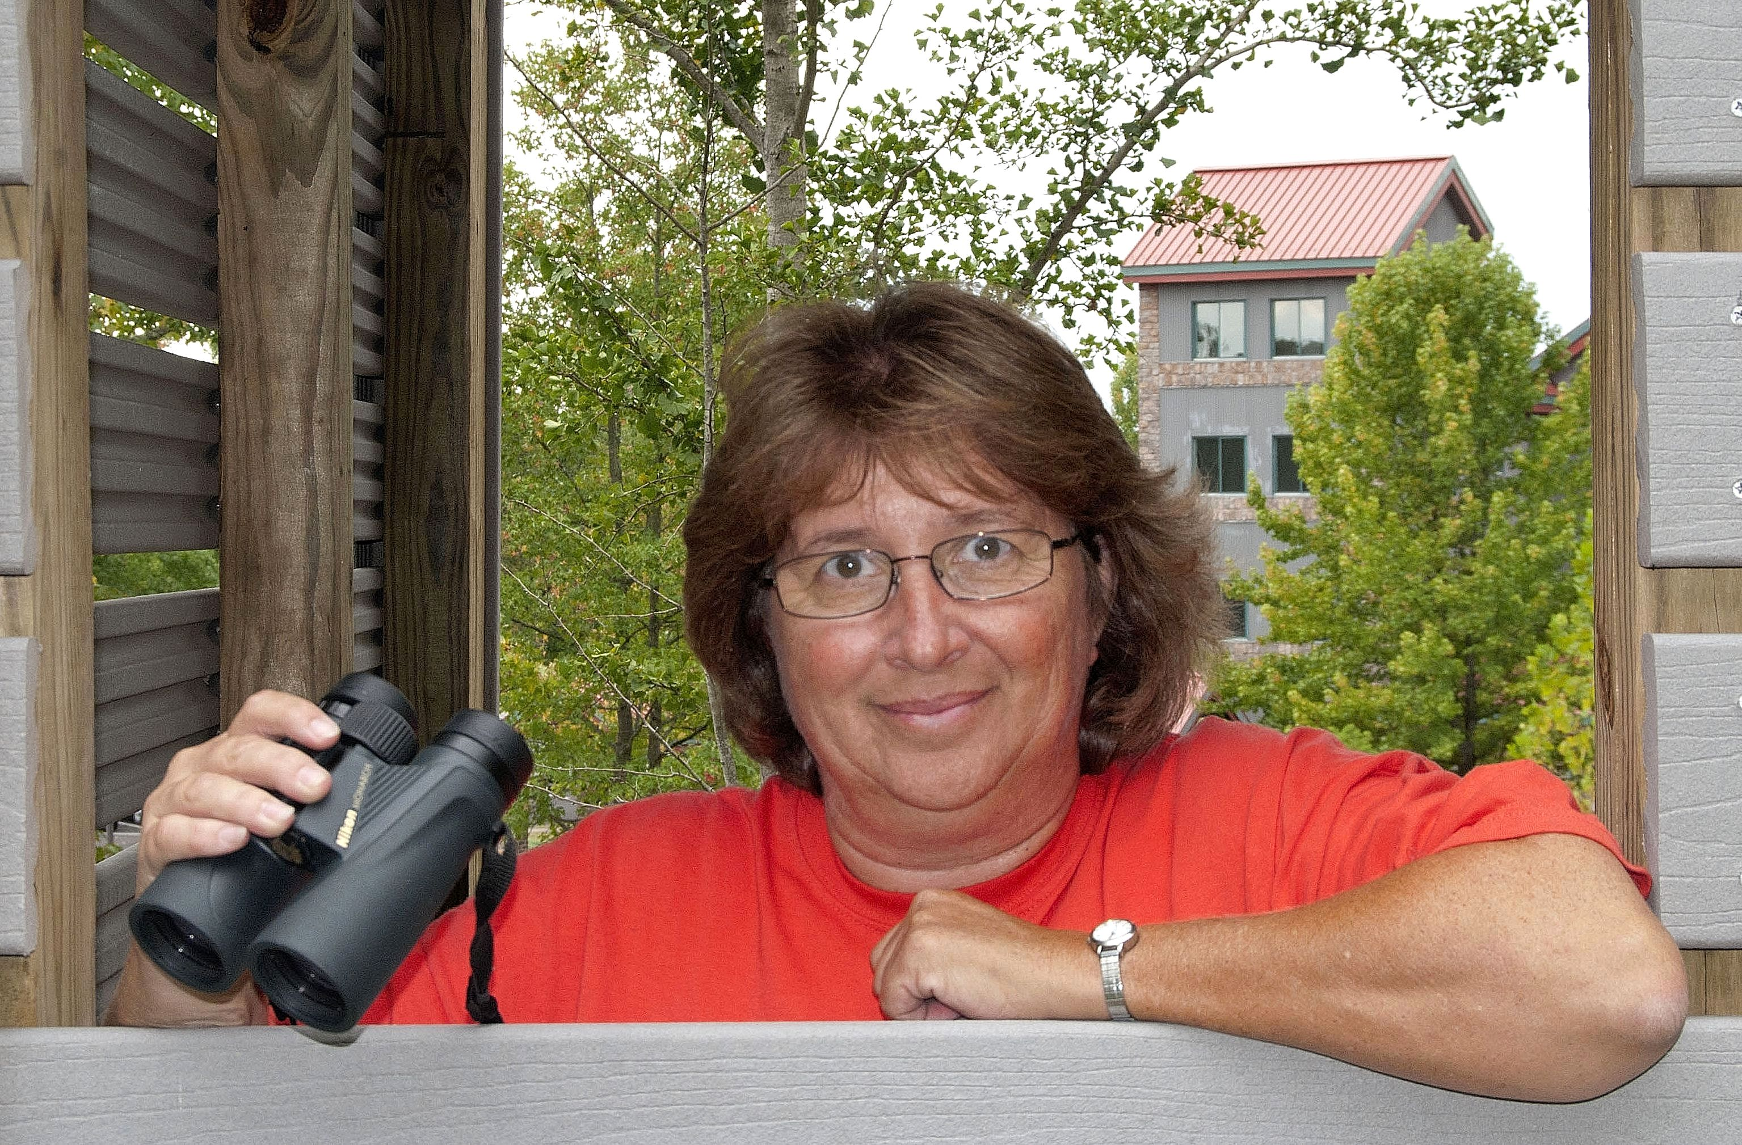
Meet your coordinator: Southeast
Lynda Andrews
Supervisory Wildlife Biologist on the Wayne National Forest
First woman to be hired full time in Kentucky Dept. of Fish and Wildlife Resources

Slide 19
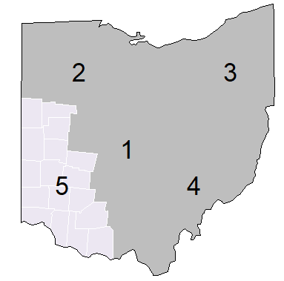
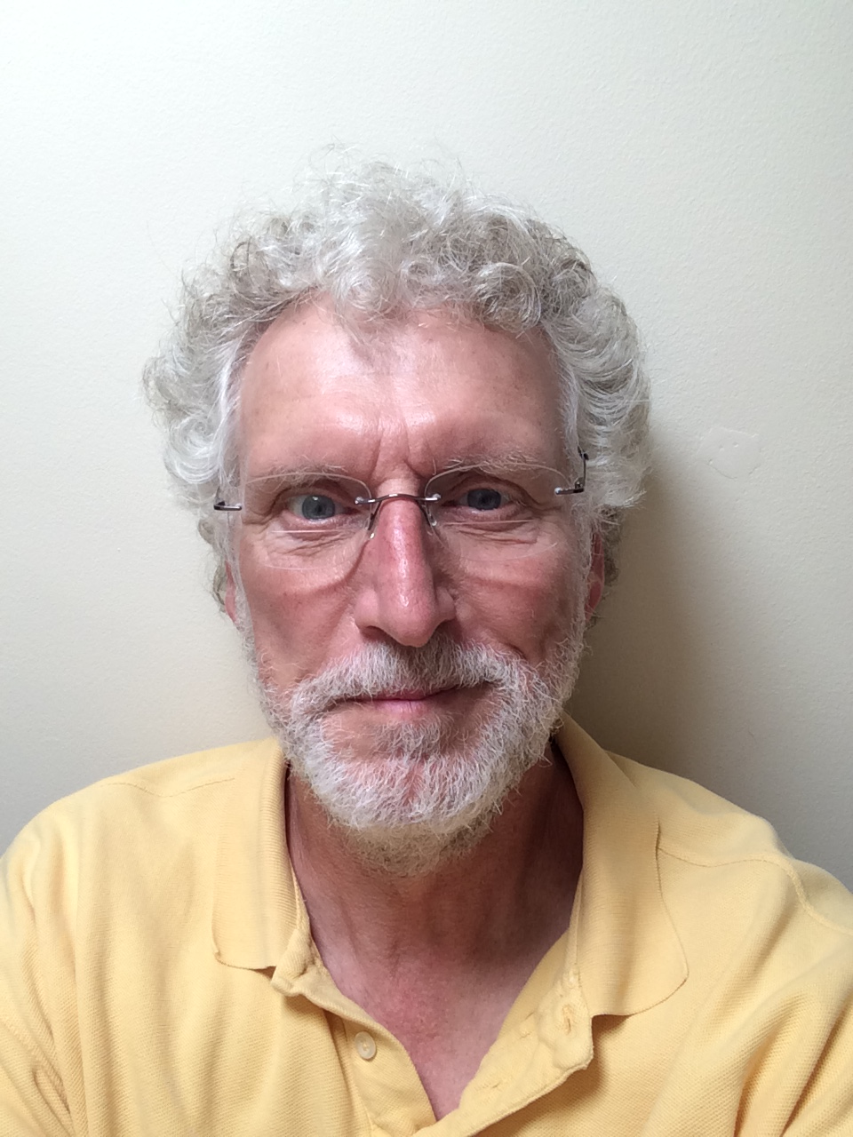
Meet your coordinator: Southwest
Jim Lemon
Retired Ohio State Entomologist
Leads tours at Cedar Bog SNP and other areas
Urbana Tree Commission co-chair

Slide 20
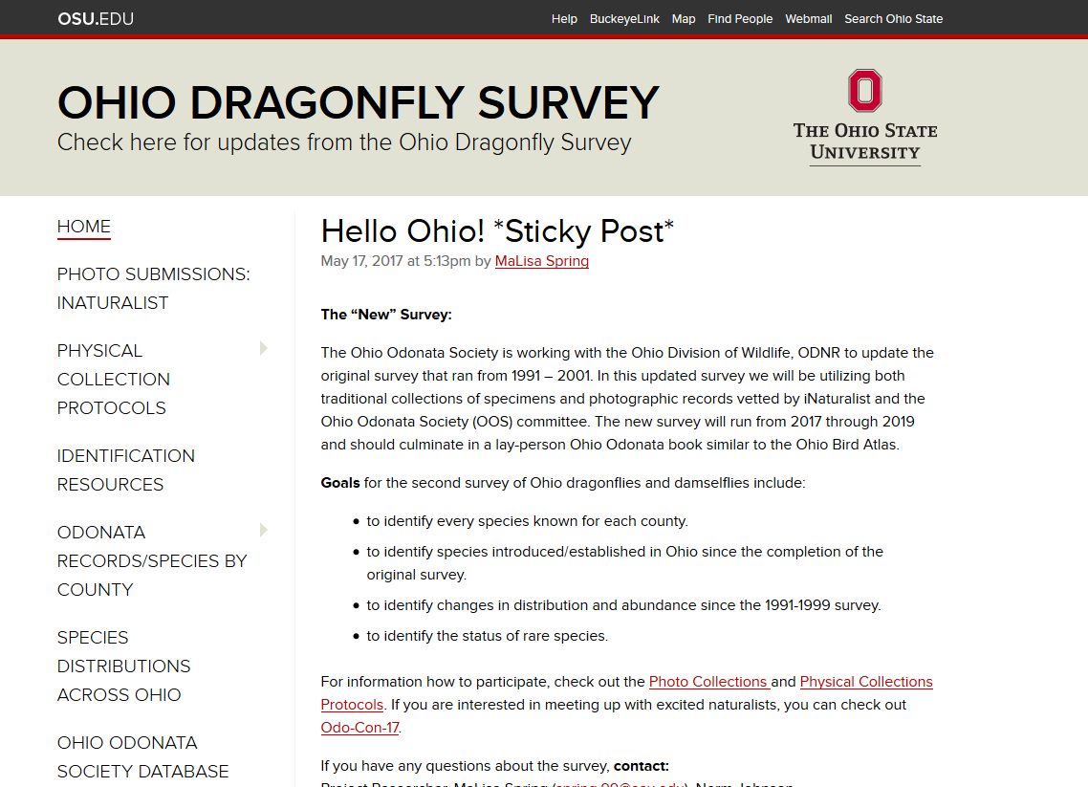
u.osu.edu
/ohioodonatasurvey/

Slide 21
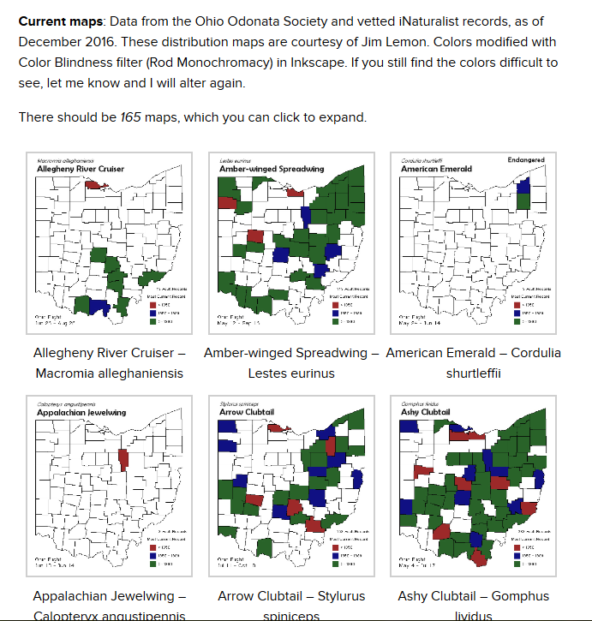
u.osu.edu
/ohioodonatasurvey/

Slide 22
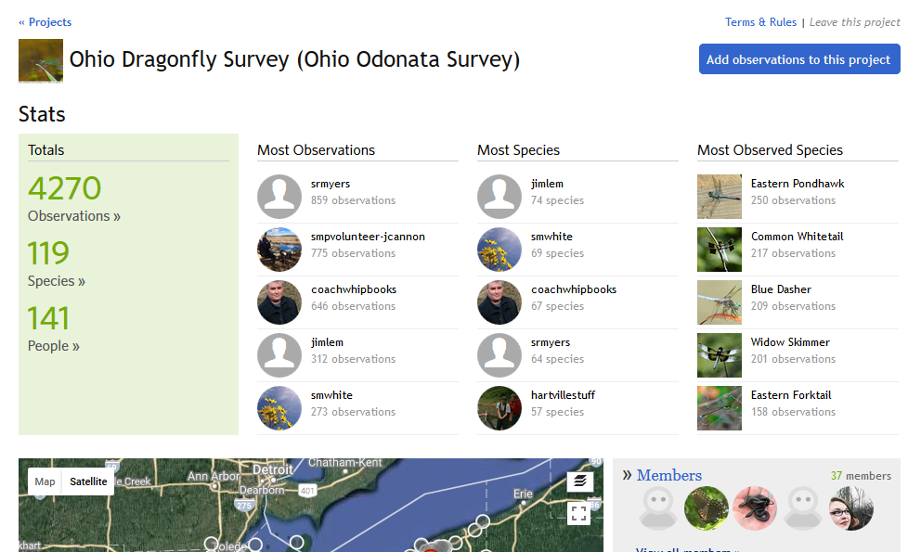

Slide 23
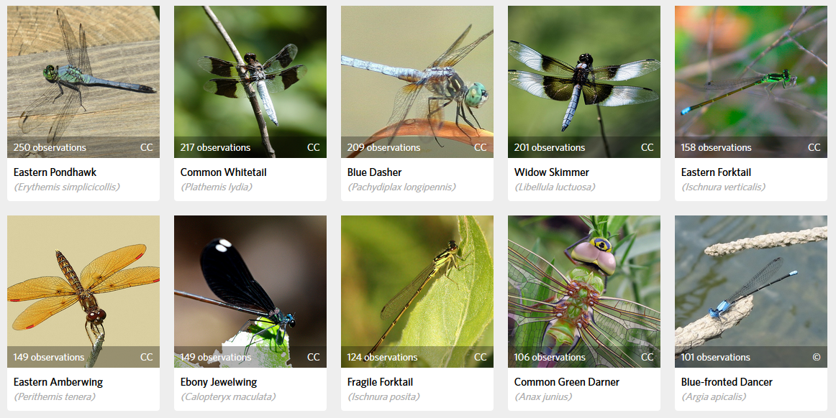

Slide 24
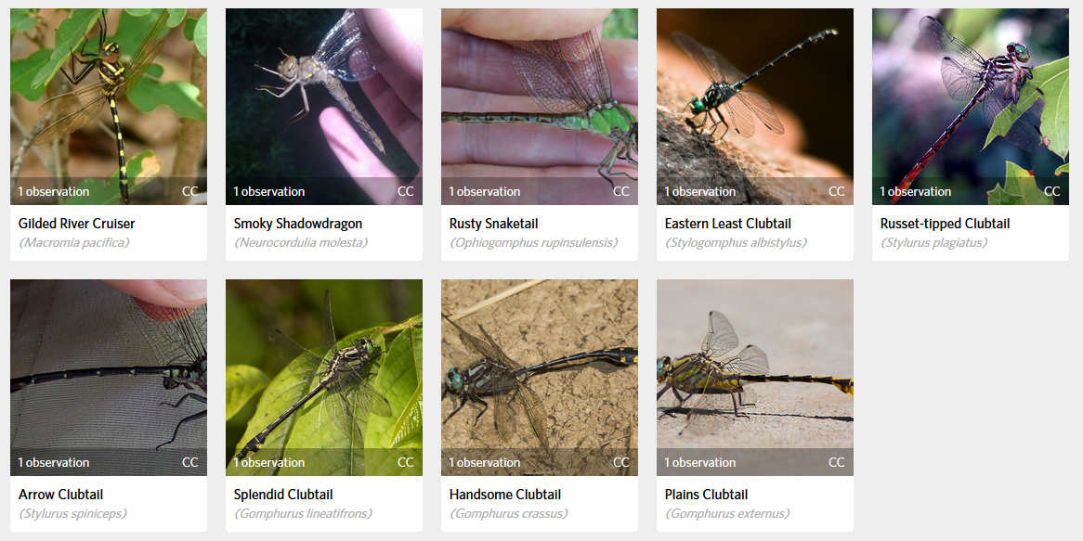

Slide 25
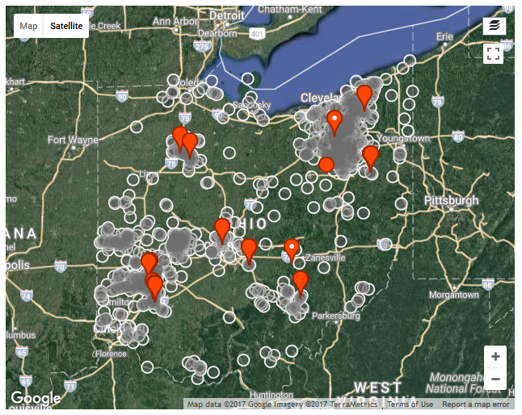

Slide 26
questions?
MaLisa Spring
Spring.99@osu.edu

